Slide 1
Visualization Assignment part (2)
File created on: 6/5/2022 10:10:33 AM

Slide 2
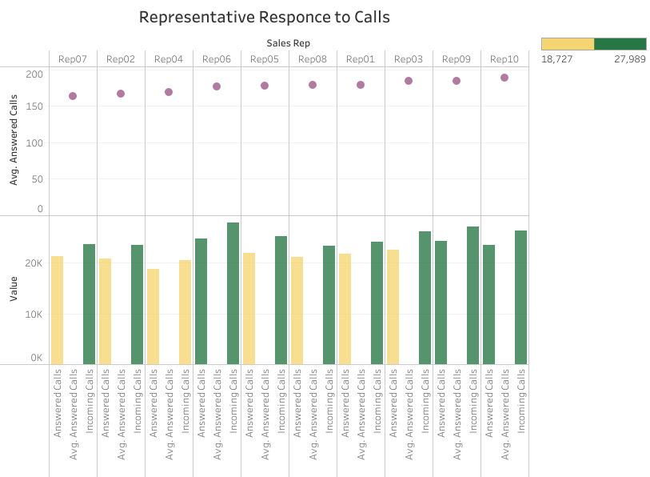

Slide 3
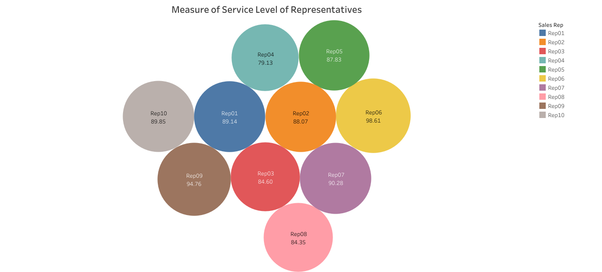

Slide 4
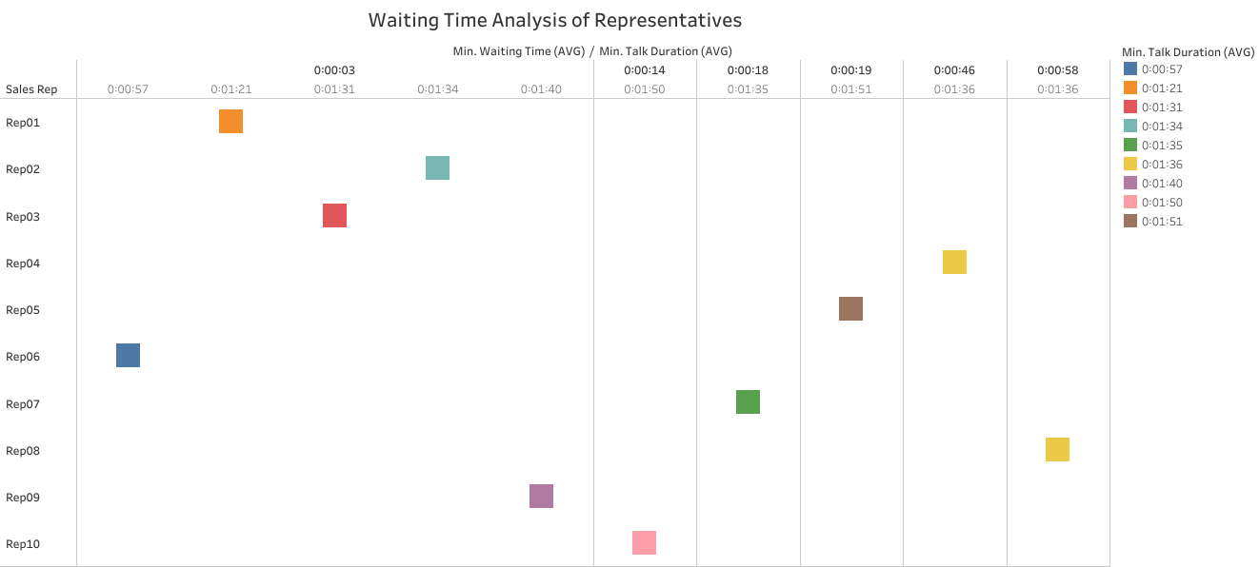

Slide 5
